Slide 1

Beyond DFT for FAIRmats
Dynamical Mean Field Theory (DMFT) and NOMAD
Jose Pizarro

Slide 2
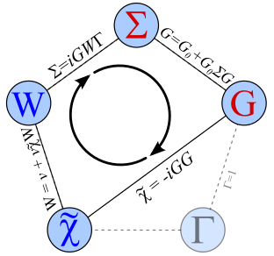
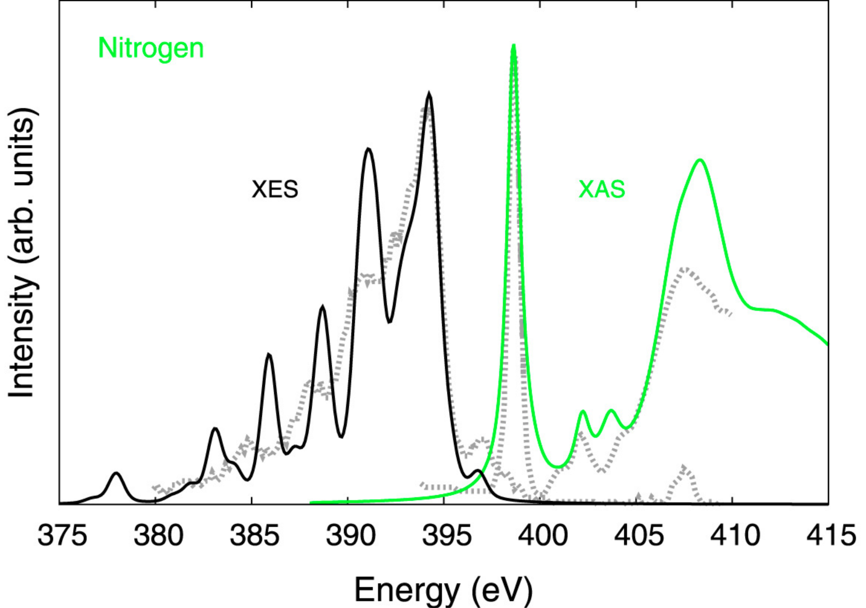
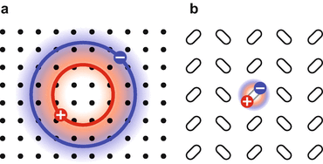
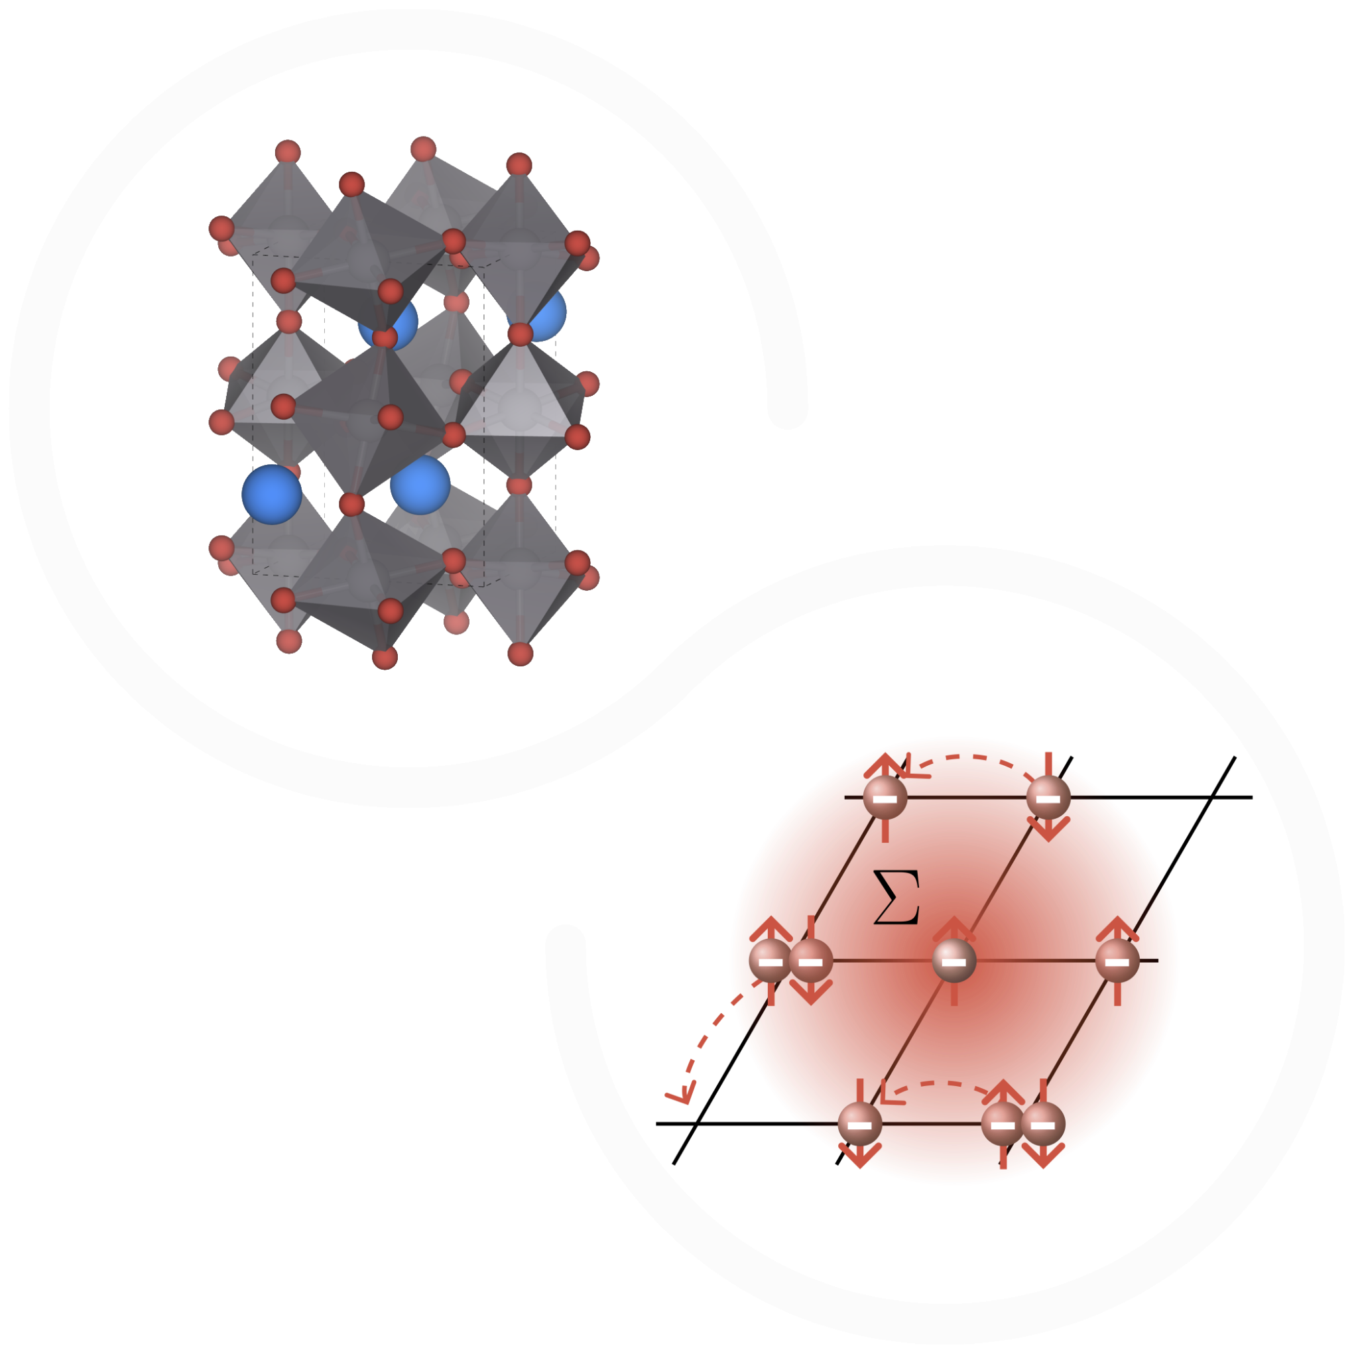
Going beyond DFT
BSE
GW
Task C3
Useful for quantitative analysis of the band gap
Useful to study bound states (excitons) and core-hole excitations
…and in general all those techniques that go beyond DFT and are useful to study dynamical and out-of-the-ground-state properties.
DMFT
Useful to study metal-to-insulator (Mott) transitions

Slide 3
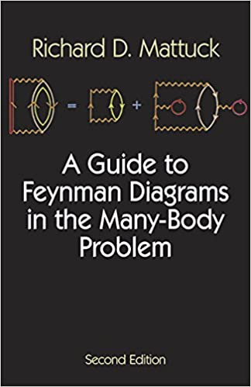
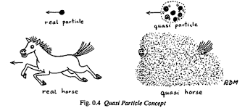
DMFT
Useful to study metal-to-insulator (Mott) transitions
Task C3
Key concepts
Mott transition
Hubbard model U, J_{H}
The Fermi liquid theory and the quasiparticle weight Z
Green’s functions formalism

Slide 4
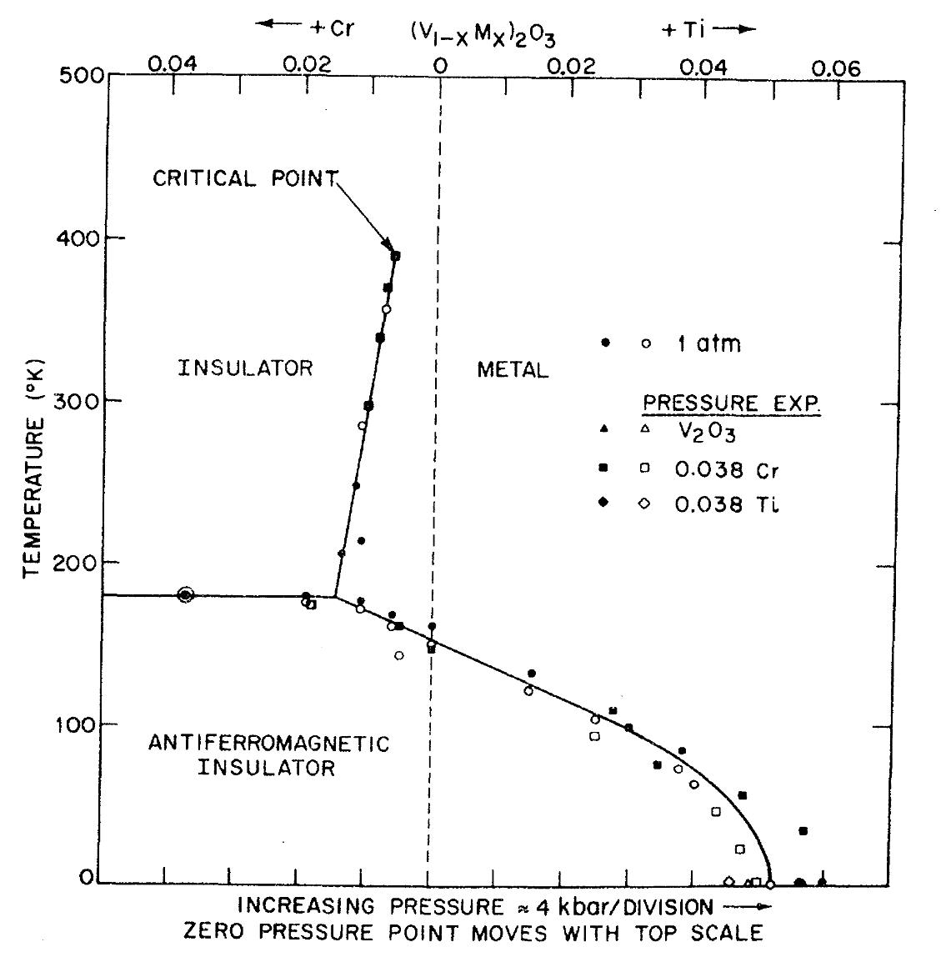
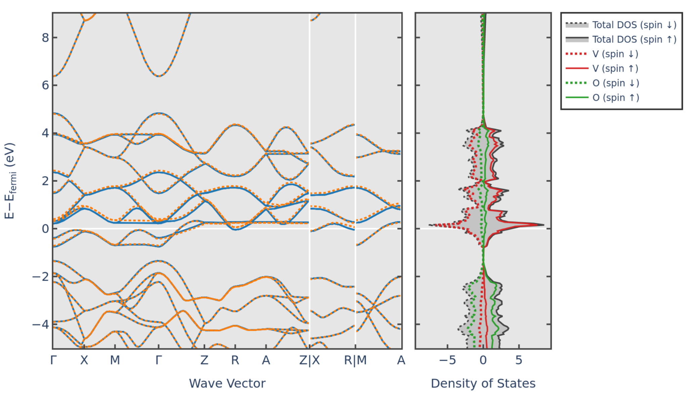
Insulators instead of metals
Some materials are known (for some time already) to be insulators (or bad metals) while DFT and band theory predicts metallic behavior
VO₂
Task C3
Materials Project ( 🙁 )
McWhan et al., PRB 1973
Experimental gap ~ 2-3 eV

Slide 5
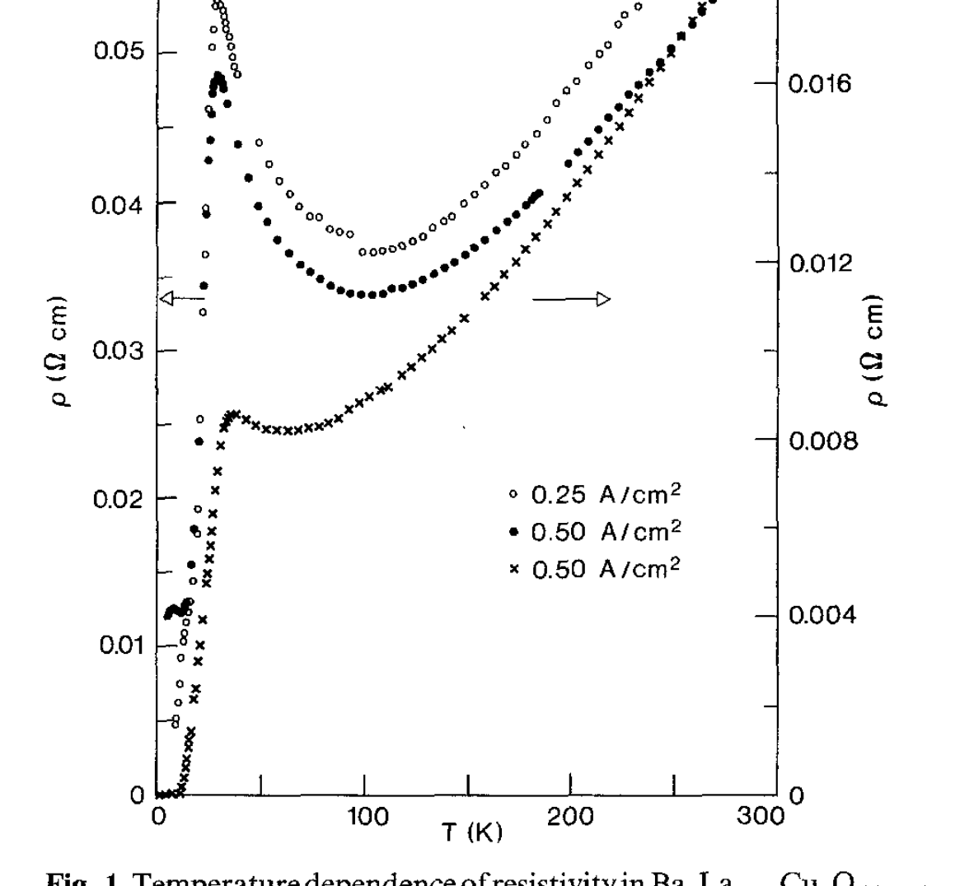
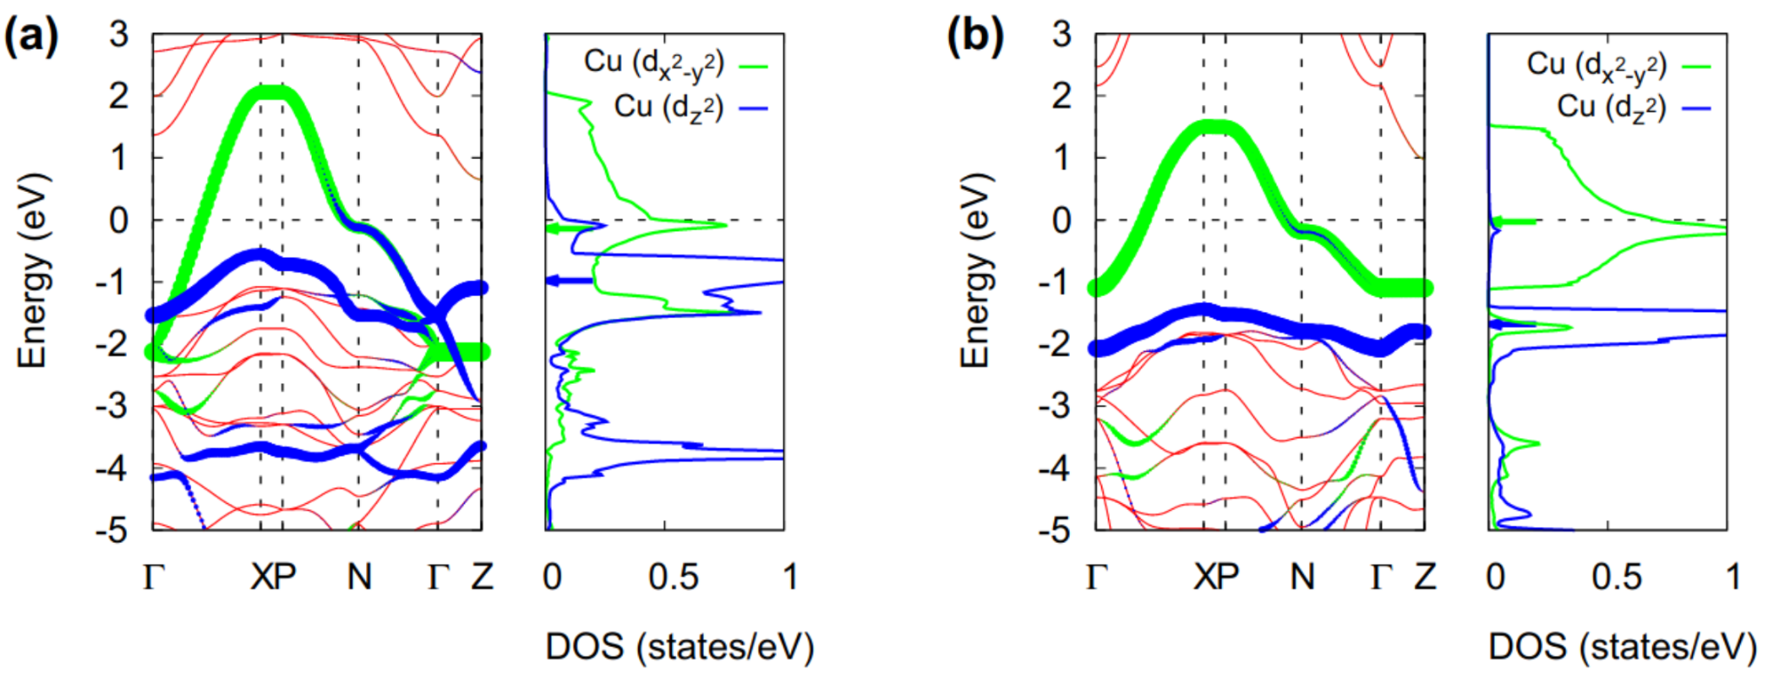
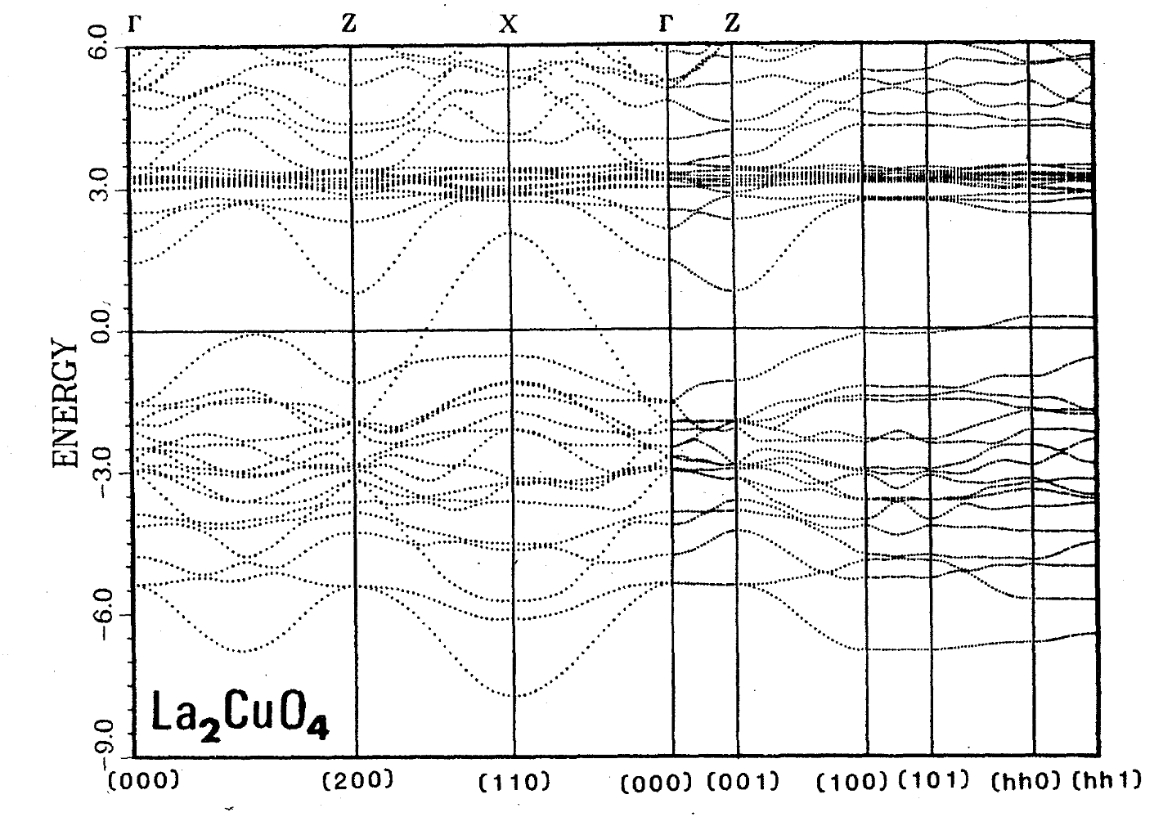
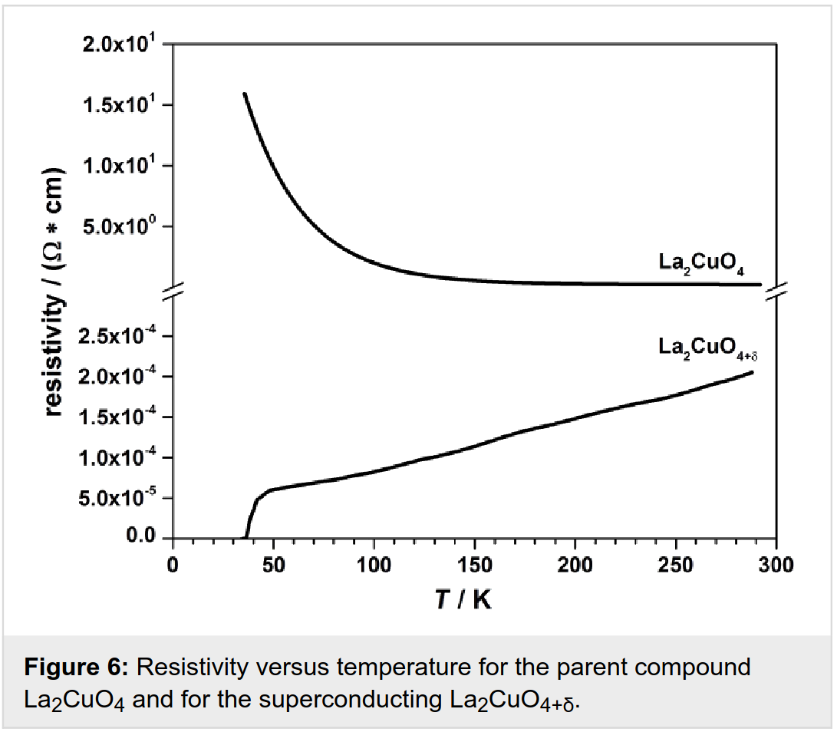
Insulators instead of metals
Some materials are known (for some time already) to be insulators (or bad metals) while DFT and band theory predicts metallic behavior → important for high-T_{c} superconductors!
cuprates
Task C3
DFT
qpGW
Berdnorz and Müller, Zeitschrift für Physik B Condensed Matter 1986
Baiutti et al., Beilstein J. Nanotechnol. 2014
Woo Jang et al., Sci. Reports 2015
Pickett, RMP 1989

Slide 6
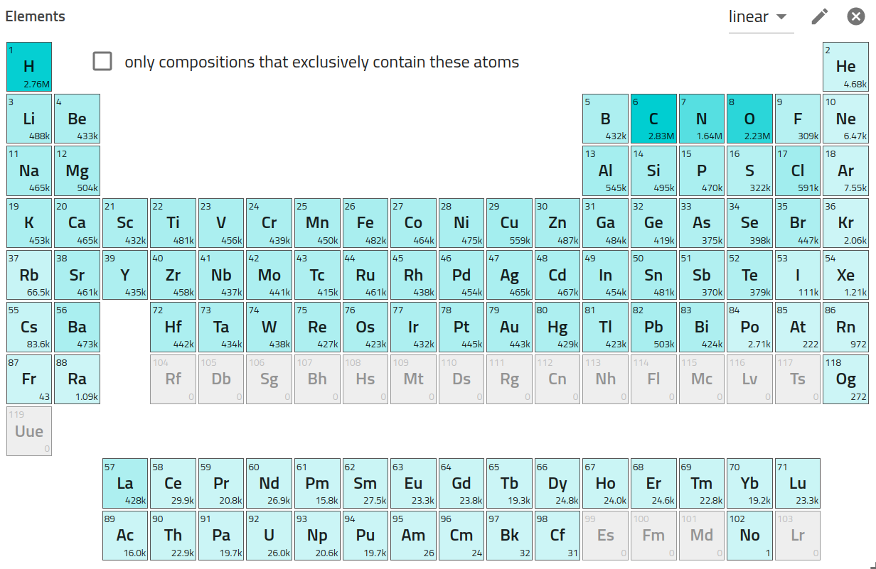
Insulators instead of metals
Some materials are known (for some time already) to be insulators (or bad metals) while DFT and band theory predicts metallic behavior → important for high-T_{c} superconductors!
Task C3
NOMAD ( 😀 )

Slide 7
Insulators instead of metals
Some materials are known (for some time already) to be insulators (or bad metals) while DFT and band theory predicts metallic behavior → important for high-T_{c} superconductors!
Task C3
Something is missing in band theory / DFT
Hubbard model and Mott transition
Dynamical Mean-Field Theory (DMFT)

Slide 8
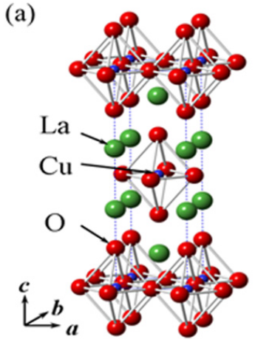
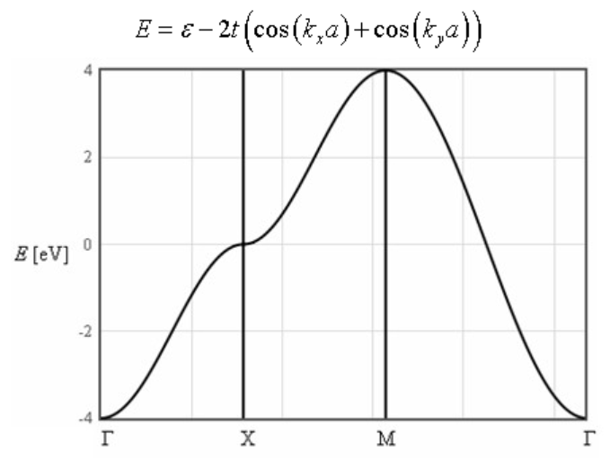
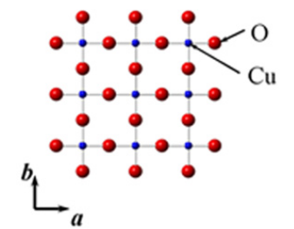
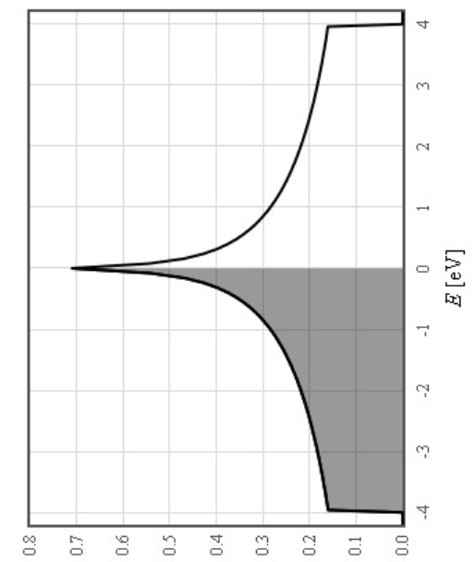
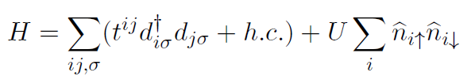
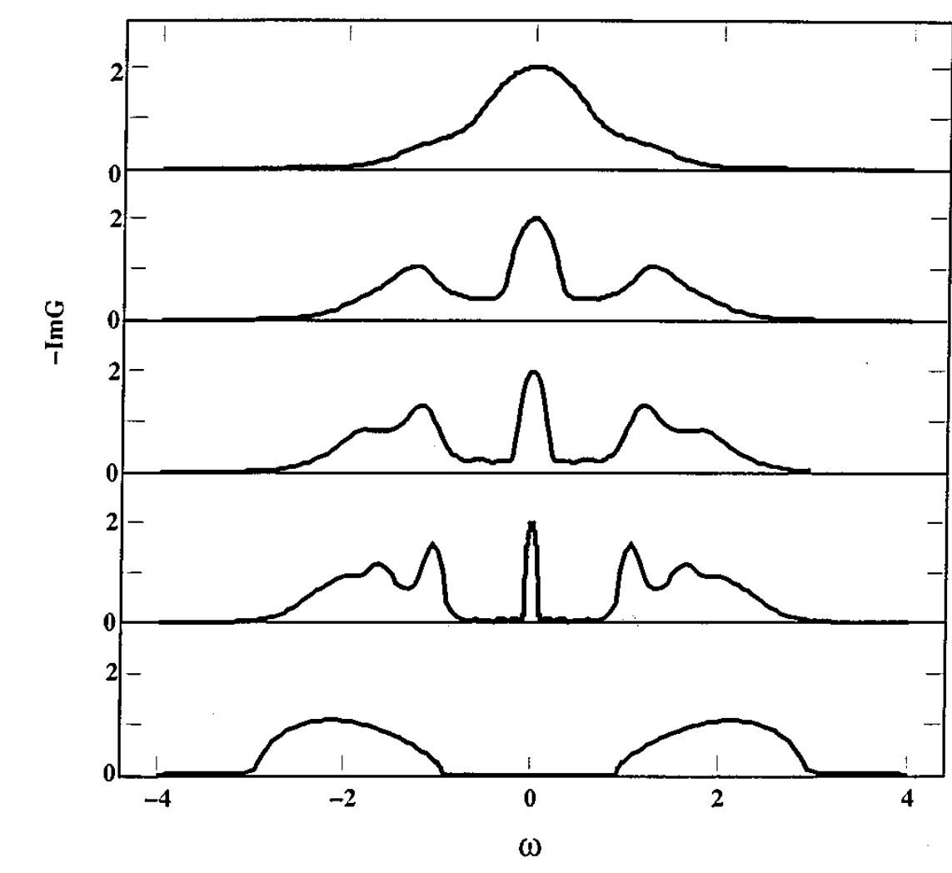
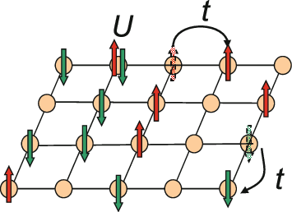
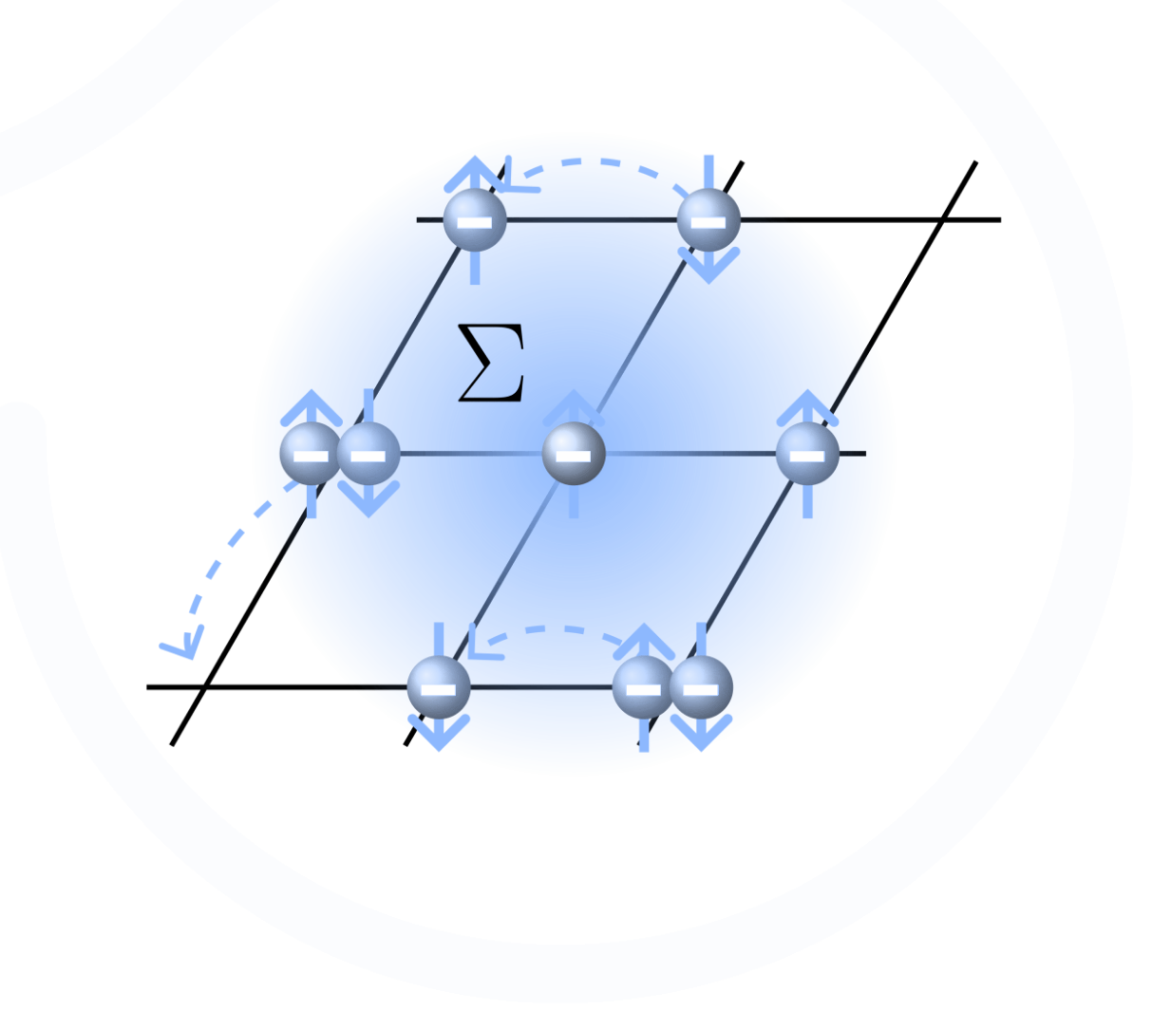
DMFT workflow
DFT
Task C3
Projection
U/W = 1
U/W = 2
…
DMFT
U/W = 4

Slide 9
Exploring the physics
Spectral density
Here, DFT results are valid
U/W = 1
Task C3
U/W = 2
…and some extra lobes (Hubbard bands) start to emerge
Here, electrons start to become heavier
U/W = 2.5
U/W = 3
U/W = 4
Finally, the Mott transition occurs!

Slide 10
Exploring the physics: the quasiparticle weight
Spectral density
m₀ / m* = Z ~ 1
U/W = 1
Task C3
U/W = 2
Not Z!
0 < Z < 1
U/W = 2.5
U/W = 3
U/W = 4
Z = 0

Slide 11
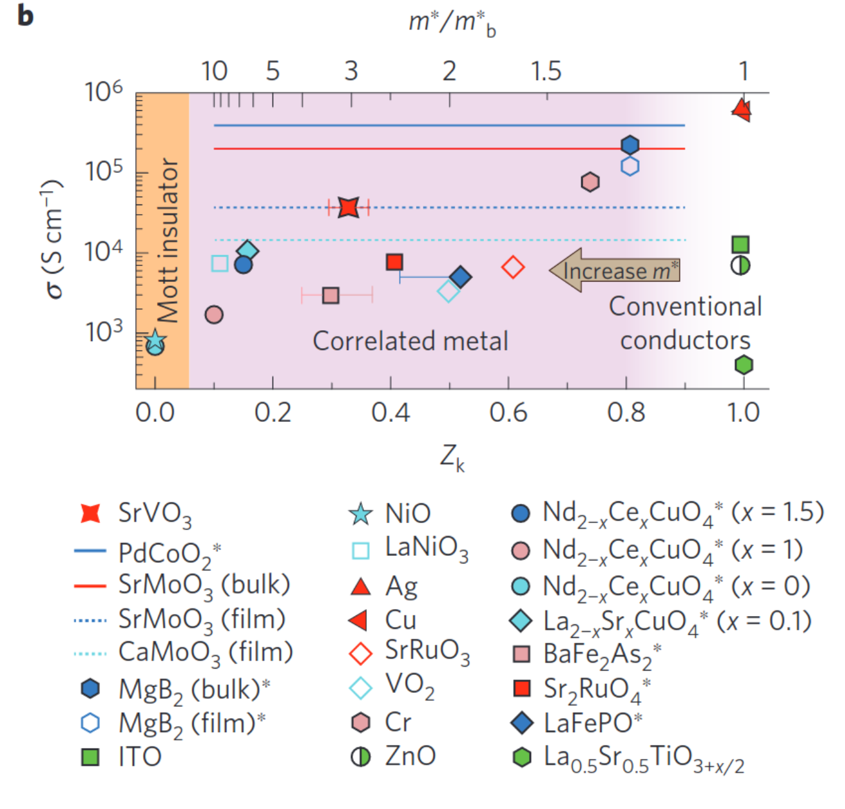
Exploring the physics: quasiparticle weight
Task C3
Zhang et al., Nat Mat 2015

Slide 12
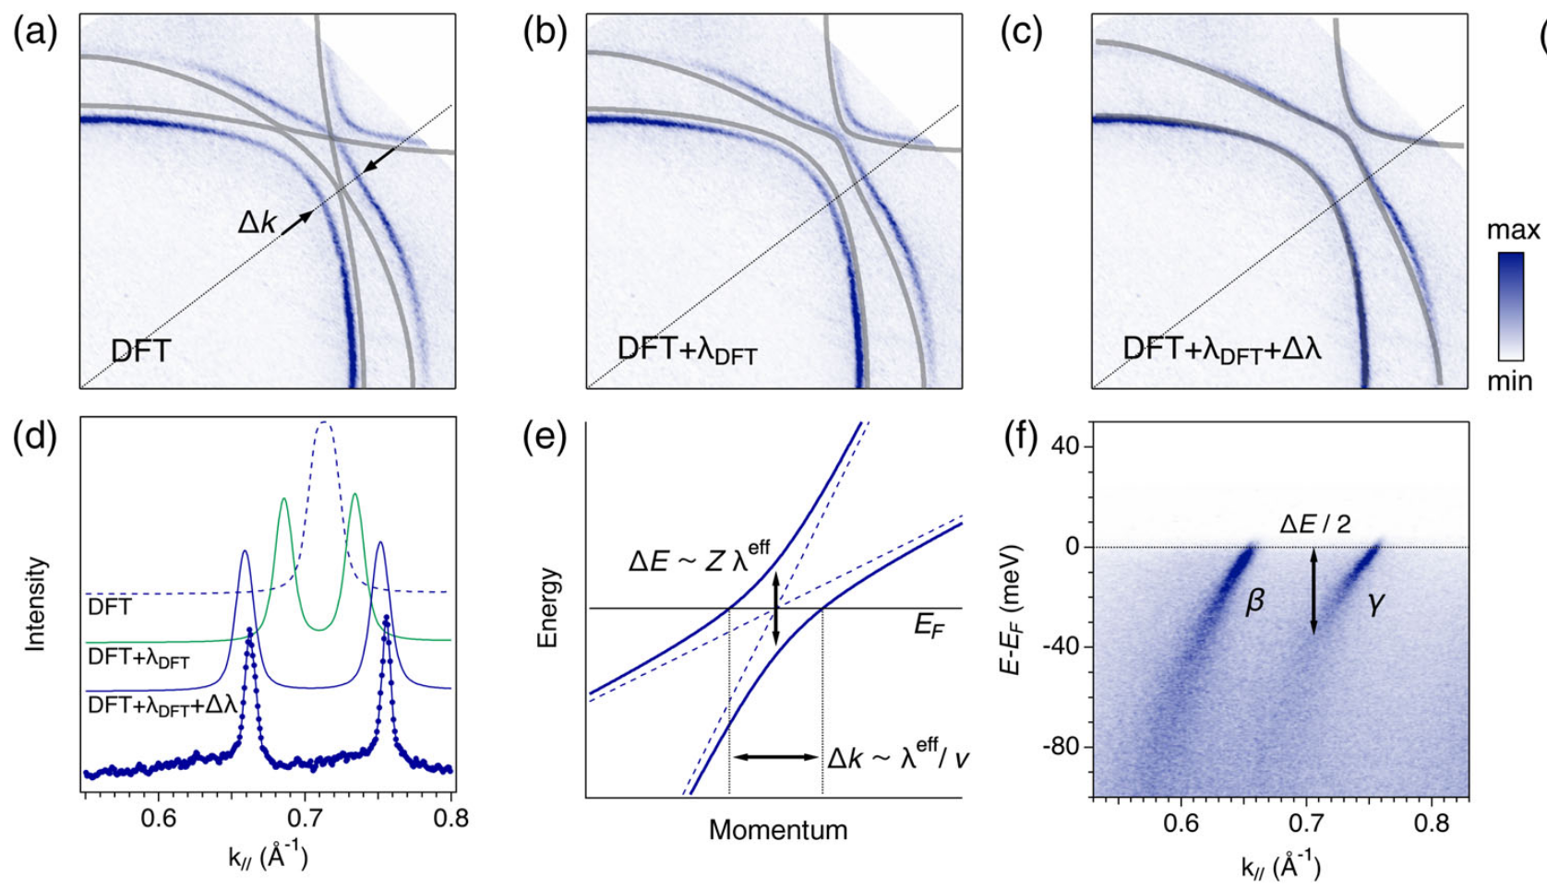
ARPES vs DFT and DMFT
Sr₂RuO₄
Task C3
Tamai et al, PRX 2019

